Slide 1
The Every Student Succeeds Act (ESSA) What YOU Can Do to Impact ESSA Implementation
Ricki Sabia
NDSC Senior Education Policy Advisor
Heather Sachs
NDSS Vice President of Advocacy & Public Policy

Slide 2
Agenda
Background & Importance of ESSA
ESSA Accountability & Implementation
ESSA Federal Advocacy
ESSA State Advocacy
ESSA and IEP Advocacy

Slide 3
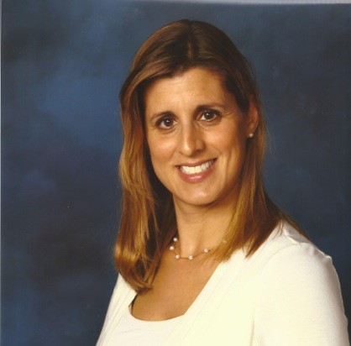
Meet the Speakers
Ricki Sabia, Senior Education Policy Advisor for the National Down Syndrome Congress
Has been an advocate for children with disabilities since 1992, when her son with Down syndrome was born.
Has worked in the federal education policy field since 2002, including as an advisor on numerous federal alternate assessment grants
Founded the National Universal Design for Learning Task Force in 2006 and chaired it until 2013.
Heather Sachs, VP of Advocacy & Public Policy for the National Down Syndrome Society
Has been an advocate for children with disabilities since 2005, when her daughter with Down syndrome was born.
Spearheads all federal, state and local policy initiatives on behalf of NDSS
One of the original NDSS DS-Ambassadors, oversees the NDSS DS-Ambassador™ Grassroots Advocacy Program
Led by Ricki Sabia, our two organizations are committed to working together on education issues, including ESSA implementation, IDEA-related issues and other education matters.

Slide 4
Background
The Elementary and Secondary Education Act (ESEA) was passed in 1965 as a civil rights law.
ESEA was amended by the No Child Left Behind Act in 2002 and by the Every Student Succeeds Act in December 2015.
The purpose of Title I of ESSA is “to provide all children with the opportunity to receive a fair, equitable and high quality education and to close educational achievement gaps.”

Slide 5
Why is ESSA Important to Your Child?
It is a general education law that applies to ALL students, but focuses on certain subgroups of students, including those with disabilities
It raises the bar under IDEA for a free appropriate public education (FAPE) and supports the need for inclusion.
It pushes the systems change that parents need in order to advocate more effectively
It can enhance implementation of IDEA if your state ESSA plan is strong

Slide 6
Before NCLB- What Isn’t Counted Doesn’t COUNT
No achievement data collected for students with disabilities
Principals, educators, parents did not know how these students performed against state content standards
School improvement plans did not include strategies targeted at students with disabilities.
Alternate assessments were not on grade level content.
No content knowledge required for special educators
We DO NOT Want To Go Backwards!

Slide 7
ESSA Good News and Bad News
Good News
NDSC was able to get important provisions added to the section of ESSA that governs alternate assessments
These provisions can be used with IDEA to raise expectations and support inclusion
Bad News
Unprecedented discretion has been given to the states. YOUR ADVOCACY COUNTS!
There are numerous limitations on the U.S. Department of Education’s authority regarding ESSA implementation

Slide 8
Effective Dates and Timeline
Most provisions were effective starting in August 2016.
US Department of Ed in 2016: has been issuing regulations and guidance on ESSA
States in 2016: are transitioning to ESSA and working on implementation plan for 2017-18
2017-2018 school year: states/districts must identify schools that need supports and improvements under ESSA

Slide 9
Accountability Changes in ESSA
Provides greater “flexibility” than NCLB in:
Assessment design
Selecting and weighting indicators for accountability and participation rate
Identifying schools for improvement and support, and what happens as a result
Teacher evaluation (no requirements except if ESSA funds are used for this purpose)
Teacher qualification, effectiveness, and experience definitions

Slide 10
How has NDSC Been Supporting Strong ESSA Implementation?
Using our education policy expertise to keep expectations high and accountability strong in ESSA proposed regulations and guidance
Informing state advocates and families about what is going on federally, and in their states, re: ESSA implementation and how they can have a role in the process.
Providing tools for use in state and local advocacy
Collaborating with NDSS to get all this information to families

Slide 11
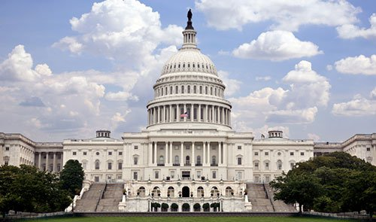
Federal Advocacy
Notes:
HS

Slide 12
Federal Proposed ESSA Regulations
Public comment period on proposed ESSA accountability regulations ended August 1- final regulations expected soon.
Public comment period on proposed ESSA assessment regulations ended September 9.
Proposed ESSA funding regulations were recently released.
THANK YOU TO PARENTS WHO RESPONDED TO ACTION ALERTS!
Notes:
Ricki
Tension between federal ED and states. Congress trying to limit the power and scope of the ED to oversee state implementation of ESSA. It was important to submit comments to support a strong role of ED in oversight.
NDSC-NDSS sent alerts on regulations on different topics, ranging from Academic Assessments to Accountability
Parent advocacy from our community was outstanding! At one point, the ED had received about 120 comments and 31 were from the DS community.
Dept of Ed has been having meetings with advocates, Ricki has been attending, giving final chance to weigh-in. All regulations likely to be finalized before the end of the year.

Slide 13
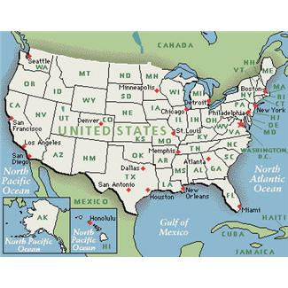
ESSA State Advocacy
Notes:
HS

Slide 14
Stakeholder Involvement Under ESSA
ESSA requires meaningful stakeholder consultation in the development of the draft ESSA plan and, afterwards, during a public comment period.
Many states not doing a good job of involving the parent/disability community.
Parent involvement is ESSENTIAL to ensure your state uses its ESSA discretion wisely.
Notes:
HS
States do not think we are watching. They are forming ESSA implementation committees and rushing the process without giving enough notice for comments. Many states are not giving disability groups a seat at the table. Need to add representation from groups representing students with disabilities, such as the Arc, DD Council.
Federal legislators are EXPECTING parents/local advocates to provide oversight on this process. Hill staff has indicated to us that they believe that the power resides with the states and it is incumbent upon the parents to get involved.

Slide 15
What Can Parents/Affiliates Do in THEIR States?
Find out about the stakeholder activities in your state re the ESSA plan and make your voices heard!
Form statewide advocacy groups
Use NDSC Google Doc with links to state stakeholder activities bit.ly/25cMbyZ
Use NDSC tools to help you provide input.
Notes:
HS
Examples of state activity – Maryland – disability community successfully banded together to get MSDE to add 2 disability representatives to the ESSA committee;
California – unsuccessful effort
Statewide advocacy groups – GAC, listservs, social media. Reach out to other disability groups (Arc, P&A, Autism groups, Cerebral Palsy, etc) AND other general education groups (e.g., PTA)
NDSC Google Doc – let Ricki know of any local updates. Hard to keep track of what is going on in each state – we depend upon your local knowledge. Will discuss later in presentation.

Slide 16
Local/District Level Advocacy
Join state and district special education advisory committees
Get to know the school board and your district’s special education administrators
Parent-teacher associations are valuable allies
Most have a special education representative
They should represent all students, including students with disabilities
Notes:
ESSA- must be stakeholder involvement in state plan, district plan, targeted support plans for schools. Variety of different places in the statute where stakeholder involvement is required; won’t come into play until 2017 and beyond.
IDEA requires that each state establish and maintain an advisory panel for the purpose of advising the State special education staff regarding the education of all eligible children with disabilities. Often districts have a similar organization (name varies, Special Education Advisory Committee, etc)
School board – testify on appropriate education-related topics; reach out to school board members and SpEd Directors at local networking events (invite them to your Buddy Walk!); get to know them and establish yourself as an ally in special education
-Approach everything AMICABLY and collaboratively at first. Will get more flies with honey than vinegar!

Slide 17
State Level Advocacy
Down syndrome Governmental Affairs Coalitions (“GACs”) – most active in CA, MA, MD, PA, TX, TN
Parent Training & Information Centers established by IDEA (name depends on state, e.g., Parent-to-Parent, Parent’s Place)
State-level Arc, PTA, AUCD, other nonprofits dedicated to inclusive education (e.g., COPAA)
Connect with organizations representing other ESSA subgroups, e.g., economically-disadvantaged, ethnic & racial groups, English-language learners
Notes:
Different groups are working on these issues. No need to lead it – can join them.
Other civil rights groups are natural allies because there is much overlap.
GACs are statewide coalitions that NDSS has helped to form that pull in parents and self-advocates from the DS community to effect policy change on the state level. Many of them have set education as their top priority. Contact Heather to get connected.

Slide 18
NDSC Tools for Families
NDSC Sample Comments can used to submit written comments to state departments of education. http://bit.ly/2csmmXr
NDSC Talking Points for General Stakeholder Input can be used to help explain certain issues raised in the sample comments http://bit.ly/2c03FIn .
NDSC State Plan Advocacy Guide can be used by those who want even greater detail about state plan development issues and advocacy. http://bit.ly/2a9boI9.
Use NDSC Google Doc with links to state stakeholder activities bit.ly/25cMbyZ
Notes:
Ricki

Slide 19
Key State Plan Accountability Issues
Minimum subgroup size-impacts whether a school is accountable for students with disabilities
Definition of consistently underperforming subgroups-impacts whether a school will be identified for targeted support and improvement.
Categories of schools identified for comprehensive support and improvement-impacts whether a school gets more funding for improvement
Indicators of school quality: impacts focus on academic achievement
Notes:
Ricki

Slide 20
Key State Plan Assessment Issues
Strategies to limit alternate assessment participation to 1%: impacts overuse
Training on state guidelines for alternate assessment participation: impacts proper IEP team decision making
Definition of students with the most significant cognitive disabilities: impacts which students take an alternate assessment
Should not be based on IQ or disability category or educational setting
Must have instruction in enrolled grade content
Notes:
Ricki

Slide 21
Key State Plan Issues Regarding Teachers and Students
Effective, experienced and qualified teachers: impacts equity
Strategies to support all students: impacts low achievement due to aversive interventions, overuse of suspension/expulsion, segregated classes/schools and lack of accessible instruction

Slide 22
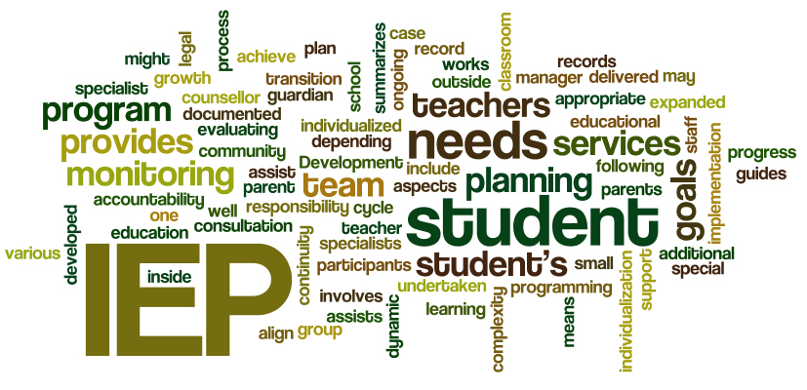
ESSA and IEP Advocacy Top 5 Things To Know about ESSA and IEP Meetings bit.ly/1WO7LJ1 Detailed document on ESSA FAQs and IEP Tips: bit.ly/1nVgGt1

Slide 23
ESSA Changes Impacting IEP
1% cap on alternate assessment participation
Emphasis on enrolled grade content
Progress in, not merely access to, general education curriculum
Proficiency = pursuit of postsecondary education or competitively paid, integrated employment
Opportunity for every student to earn a regular diploma-also new alternate diploma provisions
Development and use of accommodations to increase participation in general assessment
Universal Design for Learning (UDL)

Slide 24
Involve Self Advocates!
Self-advocates should participate in IEP meetings and local, state and federal advocacy efforts.
PowerPoint presentations or written documents can be used by ALL self advocates, regardless of reading or oral communication ability.
Helping your children understand their options for postsecondary education and employment from a young age will help with goal setting.

Slide 25
Stay Informed With NDSC
Sign up for information and action alerts on education policy by joining the NDSC email list at https://www.ndsccenter.org/stay-up-to-date-with-ndsc-news/
“Like” the National Down Syndrome Congress Governmental Affairs FB page at https://www.facebook.com/dsadvocates/
Follow NDSC on Facebook at https://www.facebook.com/thendsc/ and Twitter @policyupdates

Slide 26
Stay Informed With NDSS
Sign up for information and NDSS Advocacy Alerts at http://www.ndss.org/Advocacy/Advocacy-101/Advocacy-Alerts/
Subscribe to NDSS e-newsletter at www.ndss.org
Follow NDSS on Facebook (www.facebook.com/NDSS1979) and Twitter @NDSS1979

Slide 27
QUESTIONS?
Ricki Sabia
ricki@ndsccenter.org
www.ndsccenter.org
Heather Sachs
hsachs@ndss.org
www.ndss.org

